Slide 1

Statistical and Predictive Modeling for Analytics II
Assignment – 4
Regularization
Presented By
Kartik Sojitra (100723768)

Slide 2
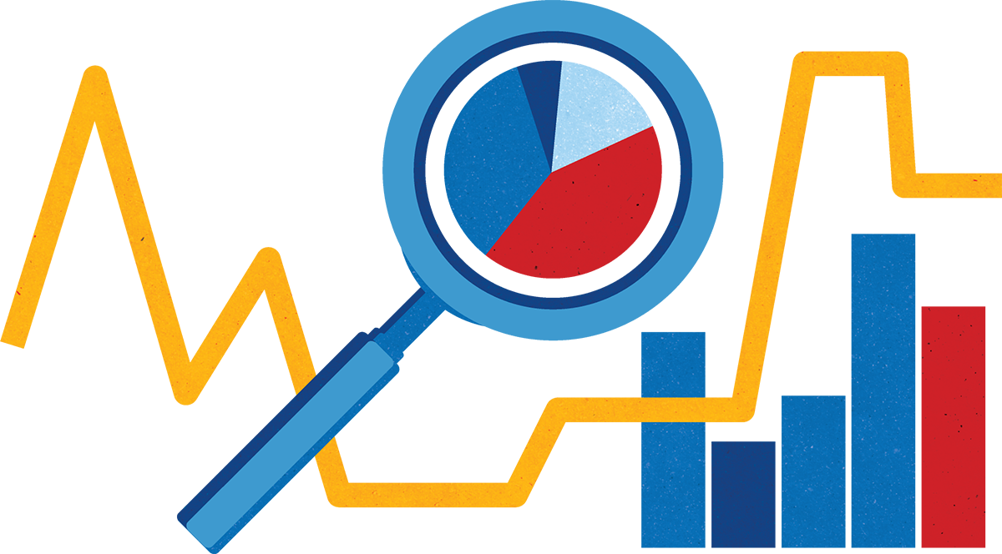
Table of Contents
Description of the Problem
Learning Curve of the Regularization Model
Optimized Regularization Models
Comparison of models
Comparison of Results
Recommendations

Slide 3

Description of the Problem
Mr. John Hughes is examining how the optimized regularization model would better help to distinguish different independent variables that are affecting the dependent variable (Active) as compared to the optimized linear regression model.
To solves the above problem we are using plusedataset.csv dataset and creating an optimized regularization model (i.e. LASSO, Ridge, and Elastic Nets).
Furthermore, the dataset is likely to be more difficult by analyzing the independent variables and the dependent variable.
In the dataset, there are 6 independent variables (Rest, Smoke, Sex, Exercise, Hgt, Wgt) and 1 dependent variable (Active).

Slide 4
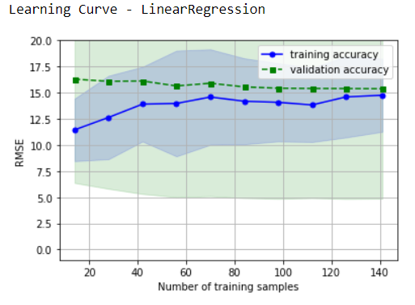
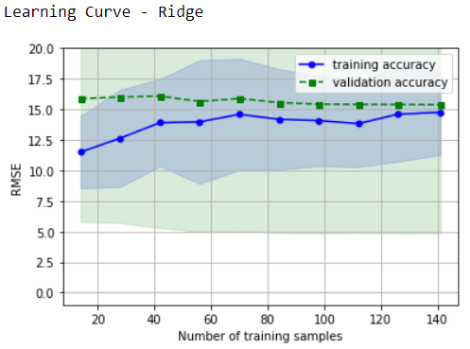
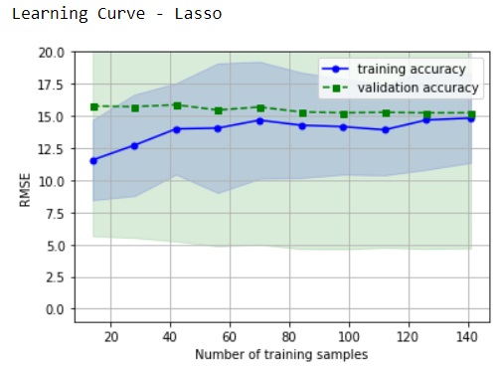
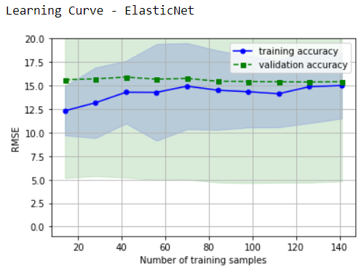
Learning Curve of the Regularization Model
Con’t

Slide 5
The LDA learning curve compares the performance of a model on training and testing data over a varying number of training instances.
The gap between the training and validation accuracy (RMSE) is decreasing consistently which represents how well the optimized generalize model can generalize to new data.
We can determine from the graph that no issue of overfitting and underfitting which illustrates that good bias-variance trade-off that means all models (LinearRegression, LASSO, elastic net, Ridge) are learning consistently and performance of models improve as the number of training points increases.
All models have higher RMSE values. Here y-axis is ‘RMSE', not ‘SCORE', so the lower the RMSE, the better the performance of the model.

Slide 6
Optimized Regularization Models
Regularization is a technique used to avoid this overfitting problem. The idea behind regularization is that models that overfit the data are complex models that have for example too many parameters. Regularization works by biasing data towards values near zero.
LASSO makes a regression model that is punished with the L1-standard. The impact is contracting coefficient esteems permitting some to get zero.
Edge Regression creates a linear regression model that is punished with the L2-standard. The impact is contracting the coefficient esteems permitting some to draw near to zero.
ElasticNet makes a regression model that is punished with both the L1-standard and L2-standard. The impact is contracting coefficients and setting a few coefficients to zero.

Slide 7
Regularization is a technique that makes slight modifications to the learning algorithm such that the model generalizes better. We need to optimize the value of the regularization coefficient to obtain a well-fitted model.
Regularization, significantly reduces the variance of the model, without a substantial increase in its bias.
For those factors who’s mean and, the standard deviation is high they influence the Active to affect most as compares to a variable whose gap is little.
We are finding outliers based on the quartiles of the data and eliminate outliers from the dataset using the Tukey method. We are creating an optimized regularization model using a new dataset (good_data) which has no outliers.

Slide 8
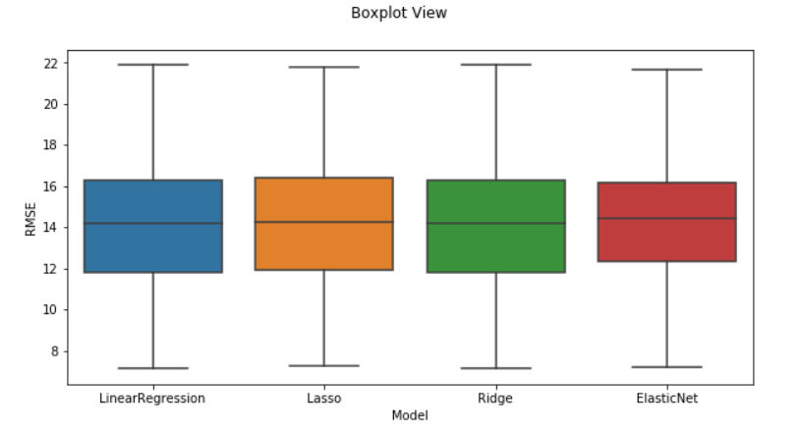
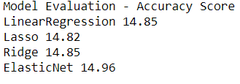
Comparison of models
We can see from the graph that the accuracy of the optimized linear regression model is almost the same as optimized regularization models, but ElasticNet has the highest accuracy of 14.96 among all models.
Con’t…

Slide 9
Comparison of Results
NestedCV for optimized regularization model is LinearRegression-14.80, LASSO-14.81, Ridge-14.74, ElasticNet-14.74 which is often used to train a model in which hyperparameters also need to be optimized.
NestedCV is used to train a model in which hyperparameters also need to be optimized. NestedCV estimates the generalization error of the underlying model and its hyperparameter search.
The value of RMSE (root mean squared error) is 14.74, which is more than 10% of the mean value of the percentages of Active (91.29) which implies our algorithm is not exceptionally exact but makes a good prediction.

Slide 10
Recommendation
Optimized linearRegression model and optimized regularization models, all have the same accuracy score around 14.75 which depicts that all models are good to perform analysis.
Smoke has 0 score in all models which represents has no effects on models and rest has a higher mean value and standard deviation that influence the dependent variable (Active) to affect most as compares to a variable whose mean is little.
Mr. John Huge would use ElasticNet because it has higher accuracy as it is penalized with both the L1-norm and L2-norm.
To improve the accuracy of optimizing the regularization models Mr. John Hughes can collect more training data and reduce the complexity of the model.

Slide 11


